Slide 1
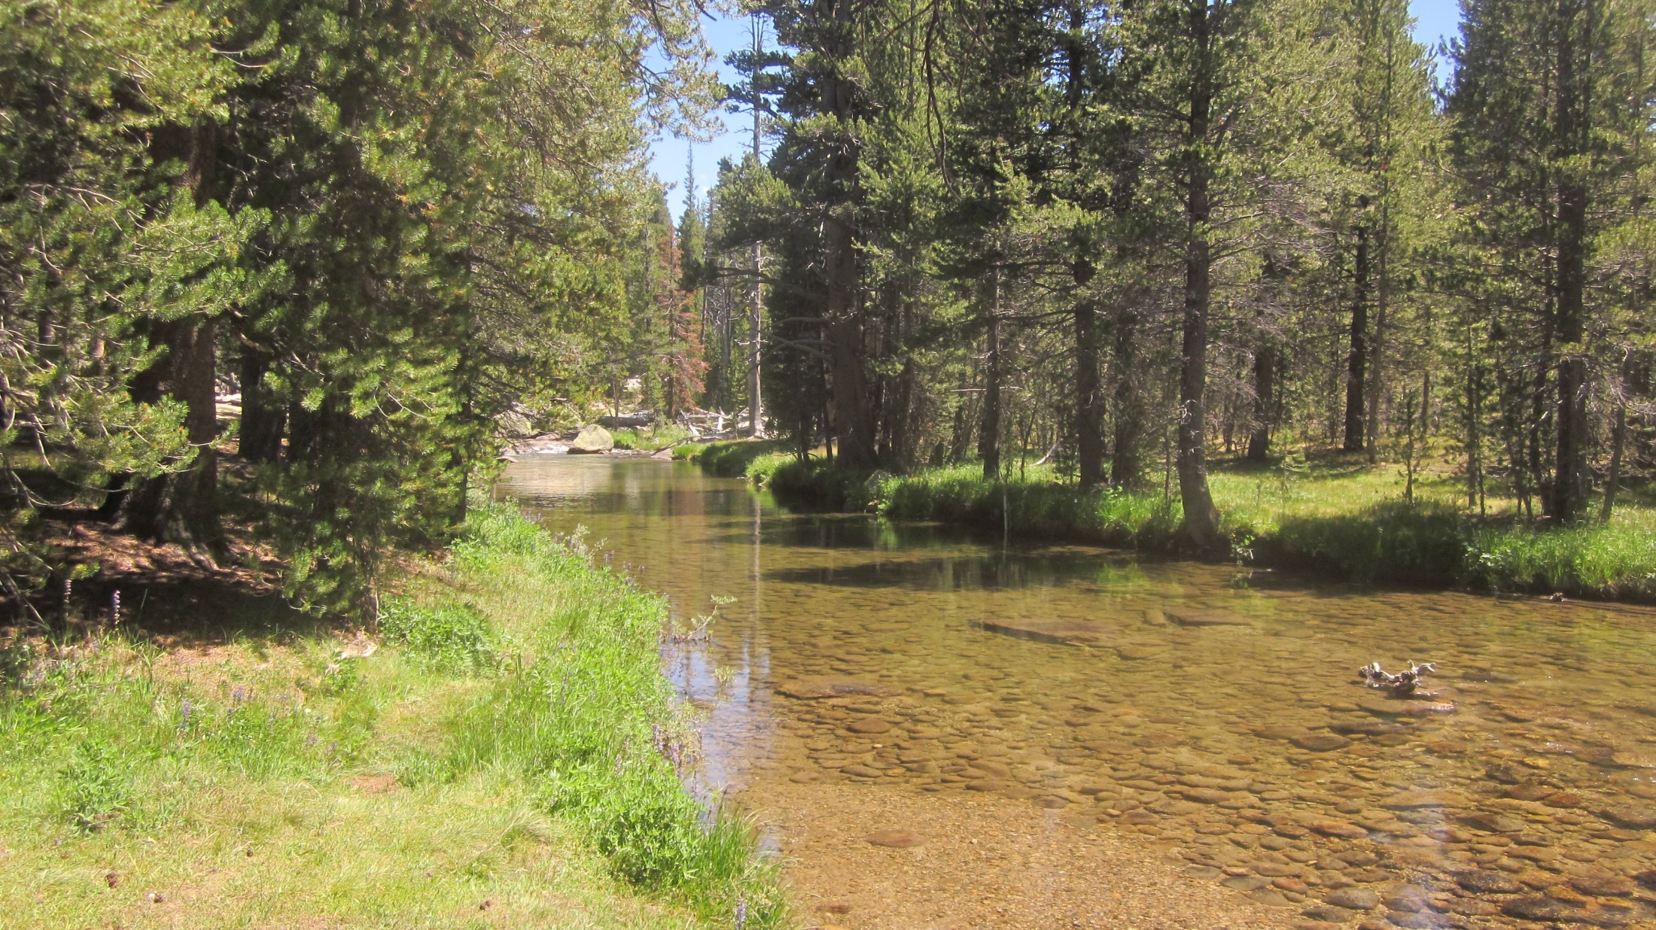
Dana Fk @ Bug Camp Gage:
updated 7/17/2015
FLOW
Photo: 7/17/2015
Initial Solinst stilling tube install: 2006
CR1000 & CS450 P.T install: 6/26/2014
Bolt benchmark install: 7/16/2015
Photo: 7/24/2012

Slide 2
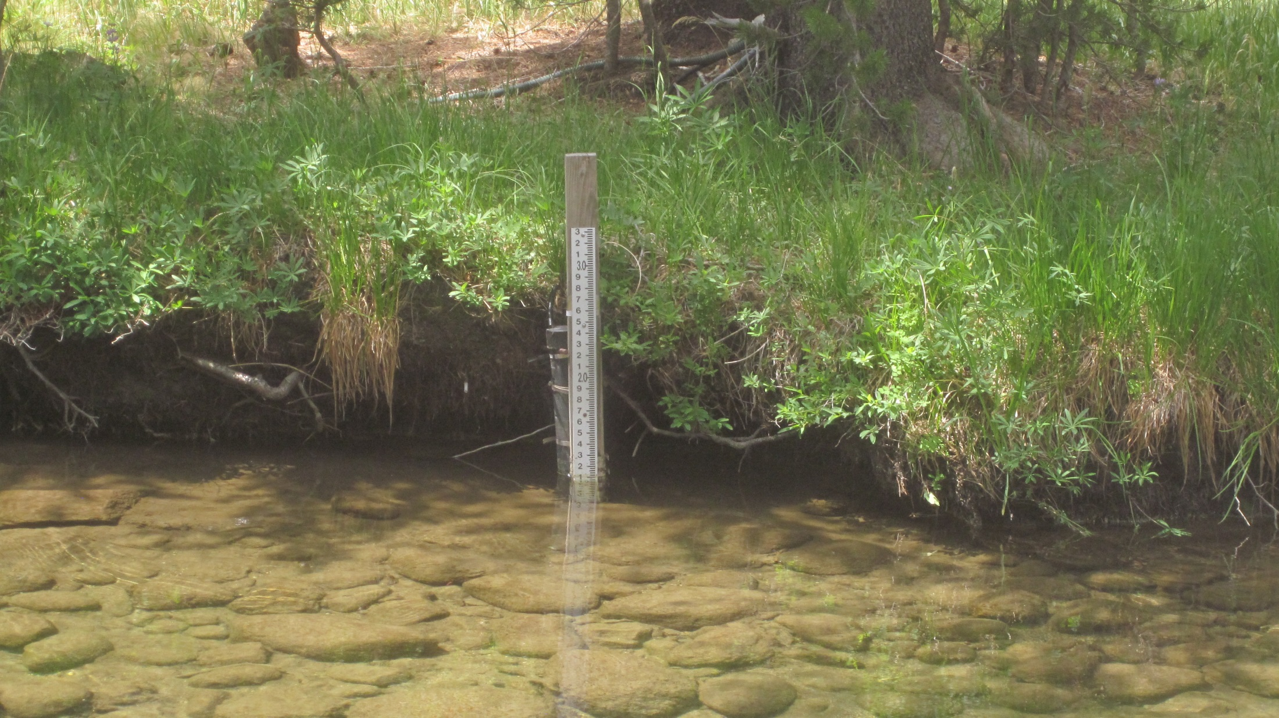
corded Solinst (Silver model) inside stilling tube install 2006 CS450 P.T (strapped to T-stake) install 6/26/2014
Staff plate gage installed 2012
FLOW
Photo: 7/16/2015

Slide 3
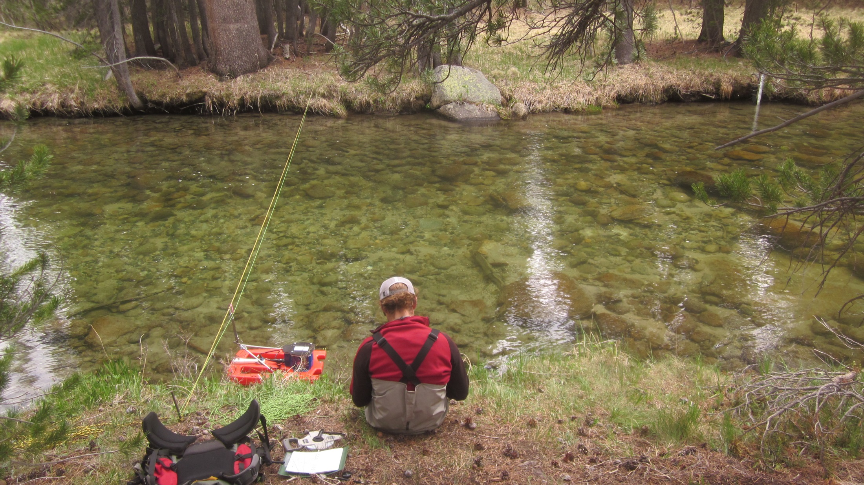

Slide 4
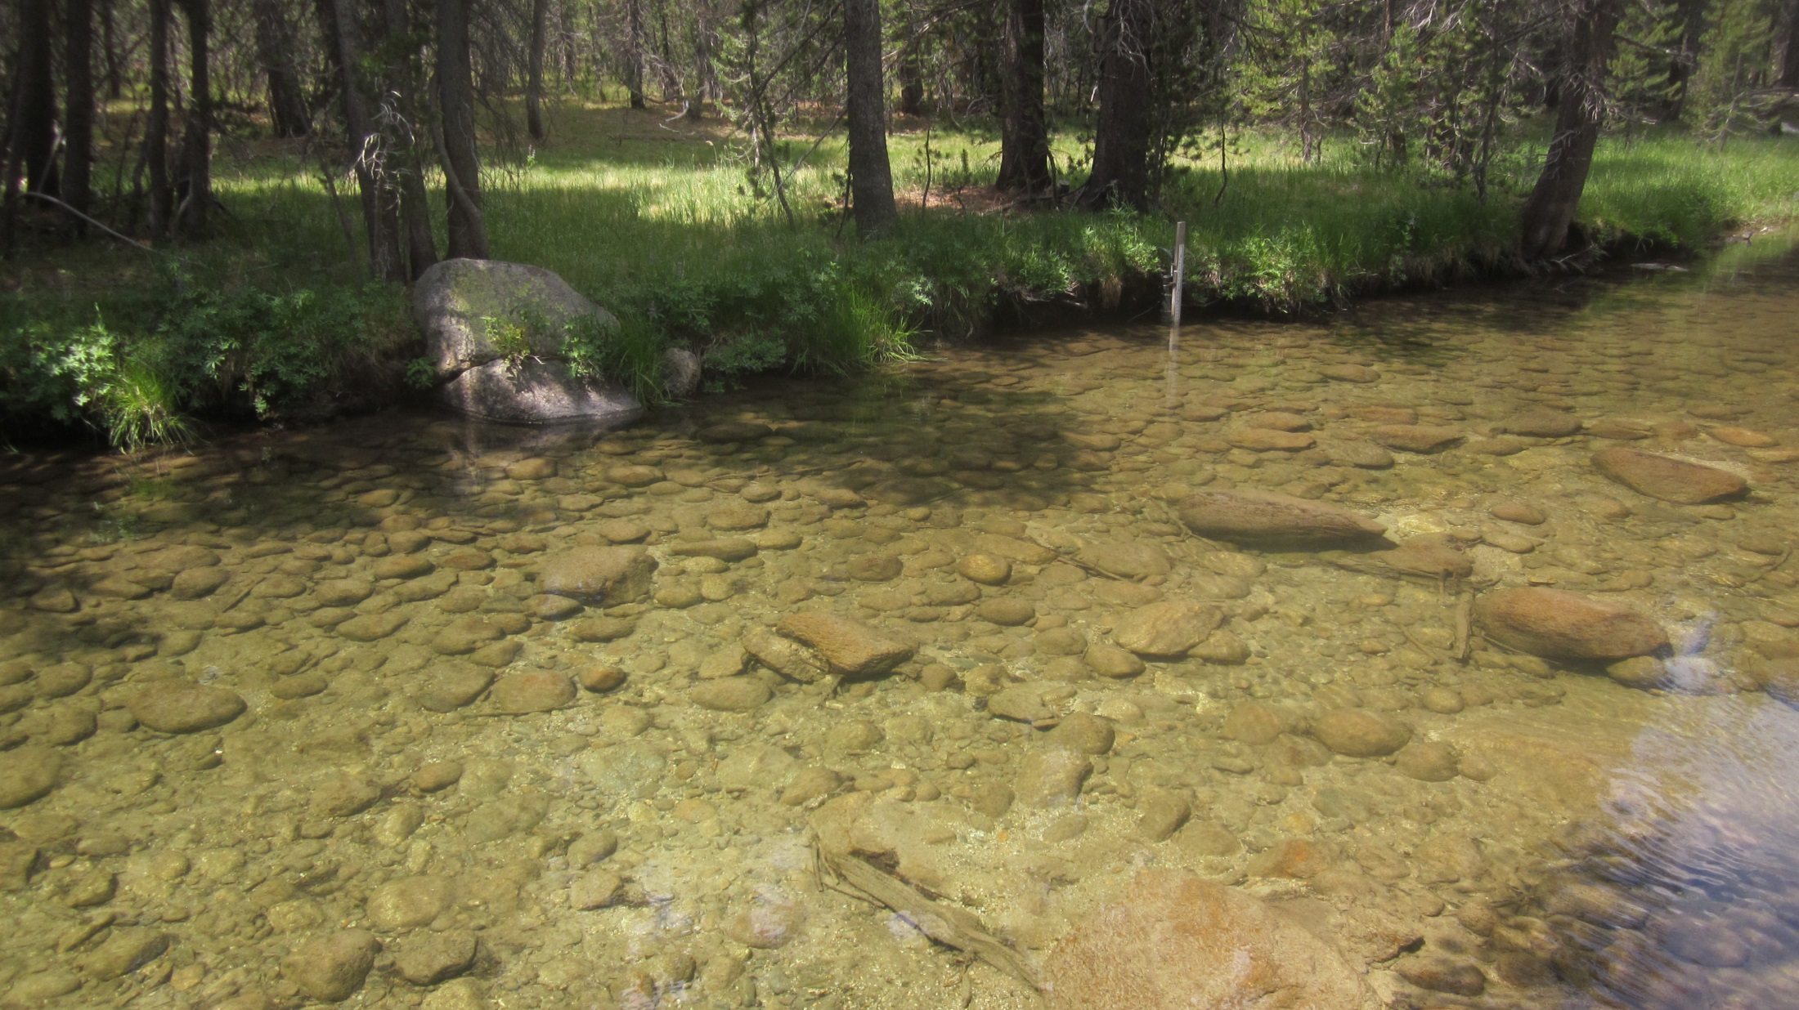
TD Bolt w/ “X” install 7/16/2015
Staff plate gage
FLOW
Photos: 7/16/2015

Slide 5
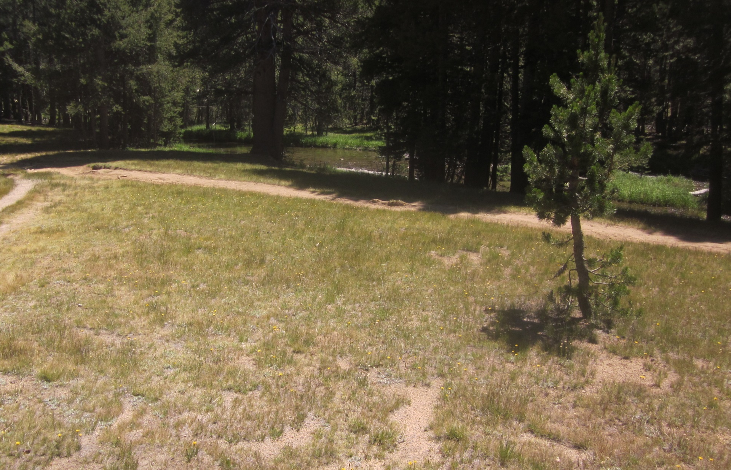
Staff plate gage
Photo: 7/17/2015
DANAFK1 GPS Control Benchmark
Installed ?

Slide 6
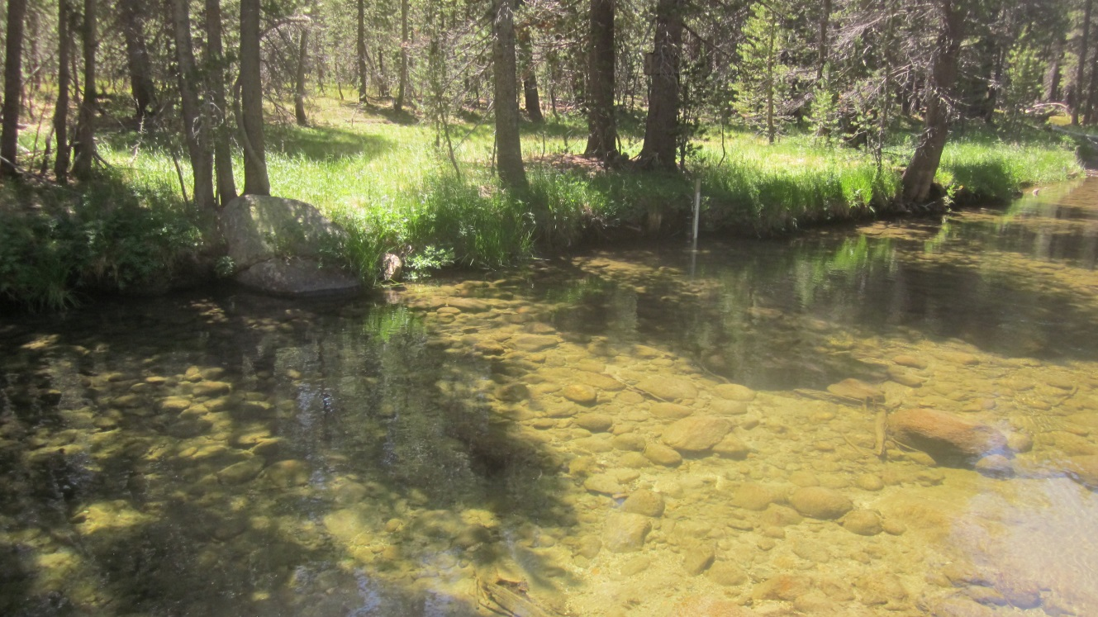
Photo: 7/17/2015
Level Survey 7/16/2015
Date Time | GH | Survey -> | Location | Benchmark manufacturer #s on stainless bolt heads | Time | Actual Survey Rod measurements (ft.) | Absolute Elevations (ft) with DANAFK1=8664.167 ft | Height of Instrument
7/16/2015 13:02 | 1.08 |  | DANAFK1 | T-post | 13:20 | 1.775 | 8664.167 | 8665.942
 |  |  | TD Bolt w/”X” | ABPFS93C(w/"X") | 13:20 | 8.175 | 8657.767
 |  |  | 3.33 ft on staff plate |  | 13:20 | 7.645 | 8658.297
 |  |  |  |  |  |  |  | 5.87 | Diff: DanaFk1 - 3.33ft GH
 |  |  |  |  |  |  |  | -0.53 | Diff: TD Bolt w/”X” - 3.33ft GH

Slide 7
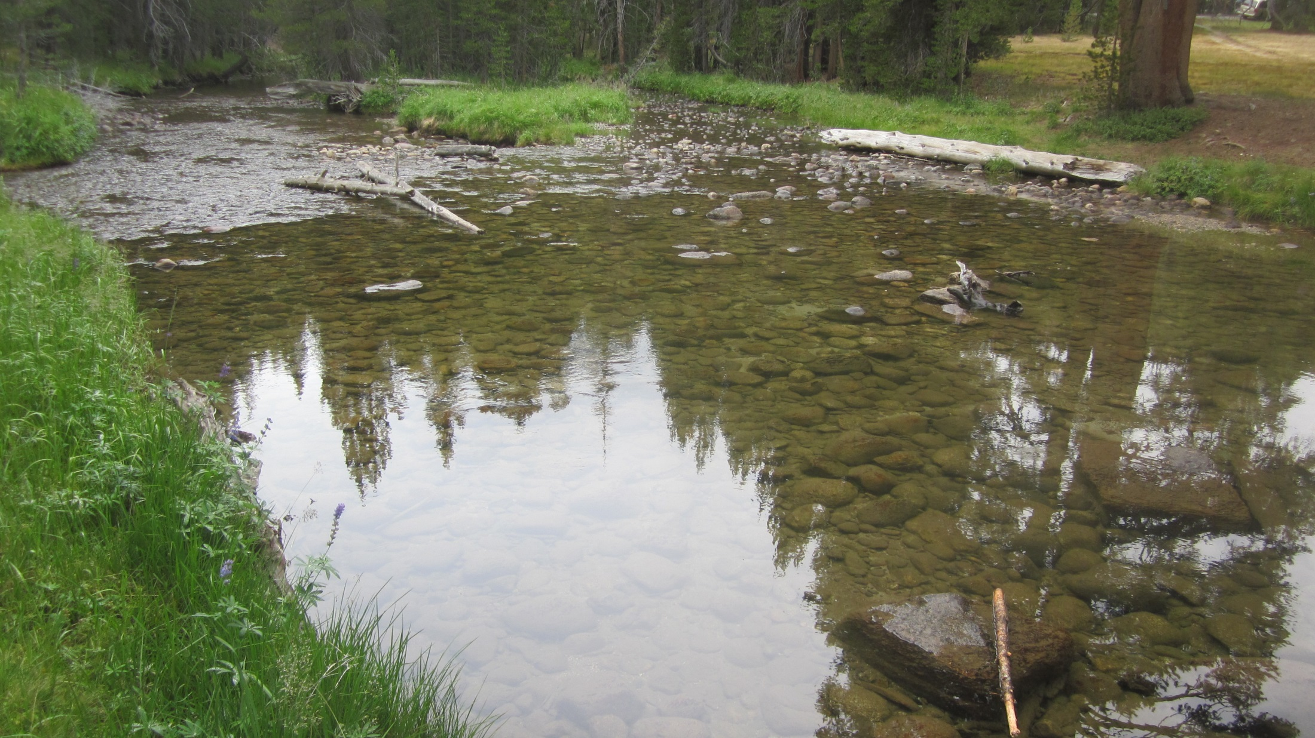
Section control:
cobble bar-difficult to identify “deepest point”
FLOW
GH of zero flow on 7/31/2015: 0.89ft – 0.85ft= 0.03ft

Slide 8
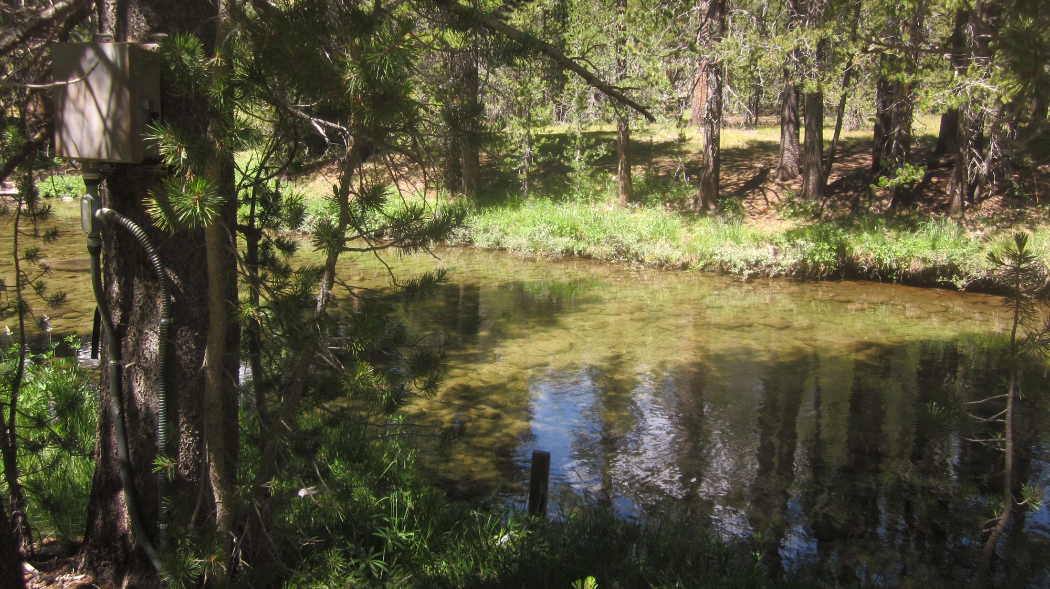
Datalogger enclosure
Staff plate gage
FLOW
Photo: 7/17/2015

Slide 9
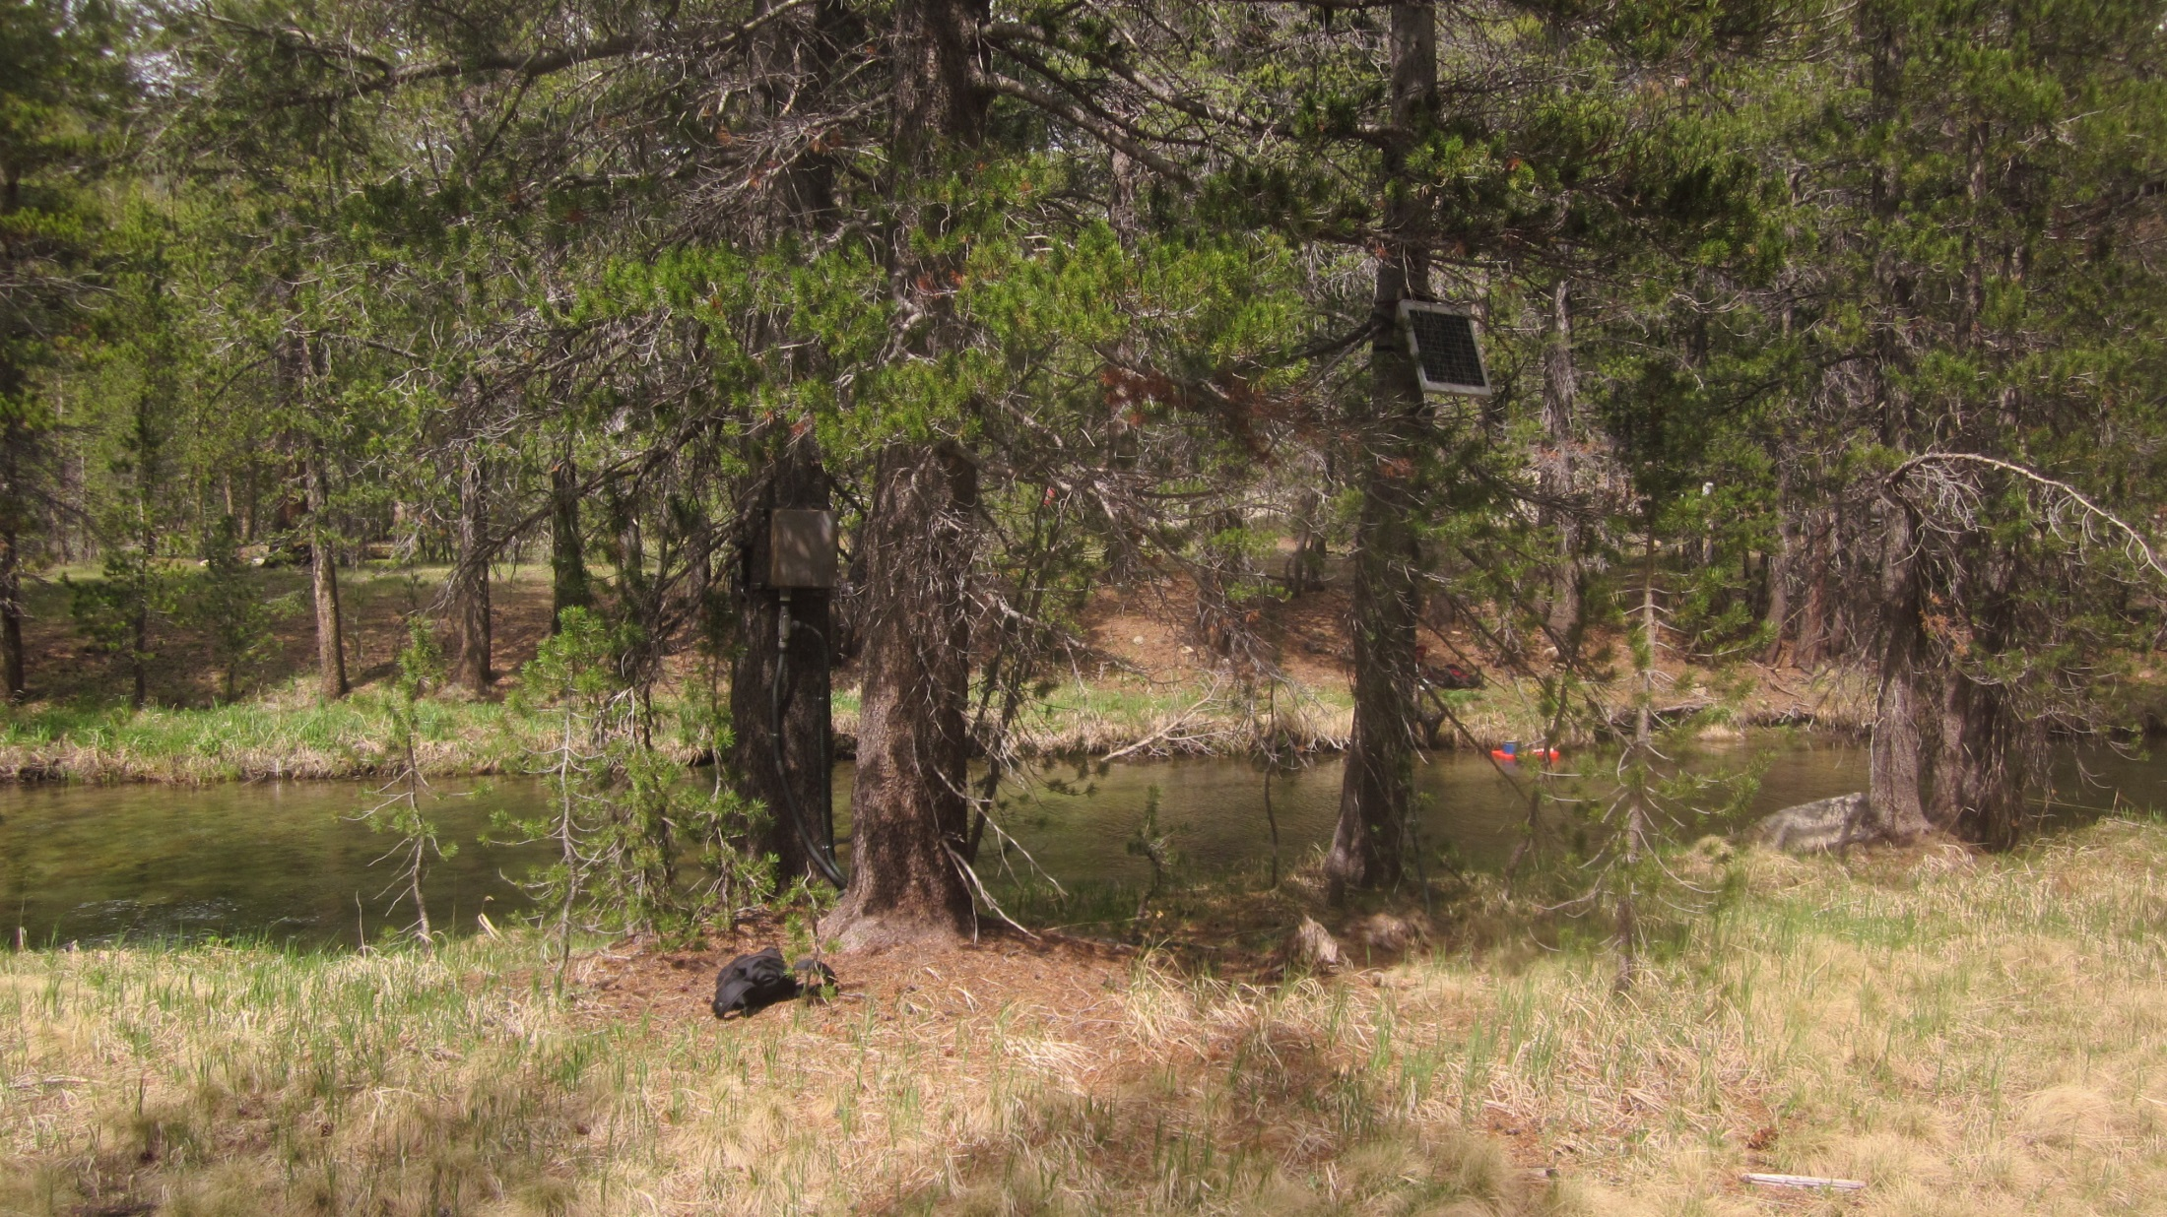
Datalogger enclosure
25 W Solar panel
Photo: 6/9/2015

Slide 10
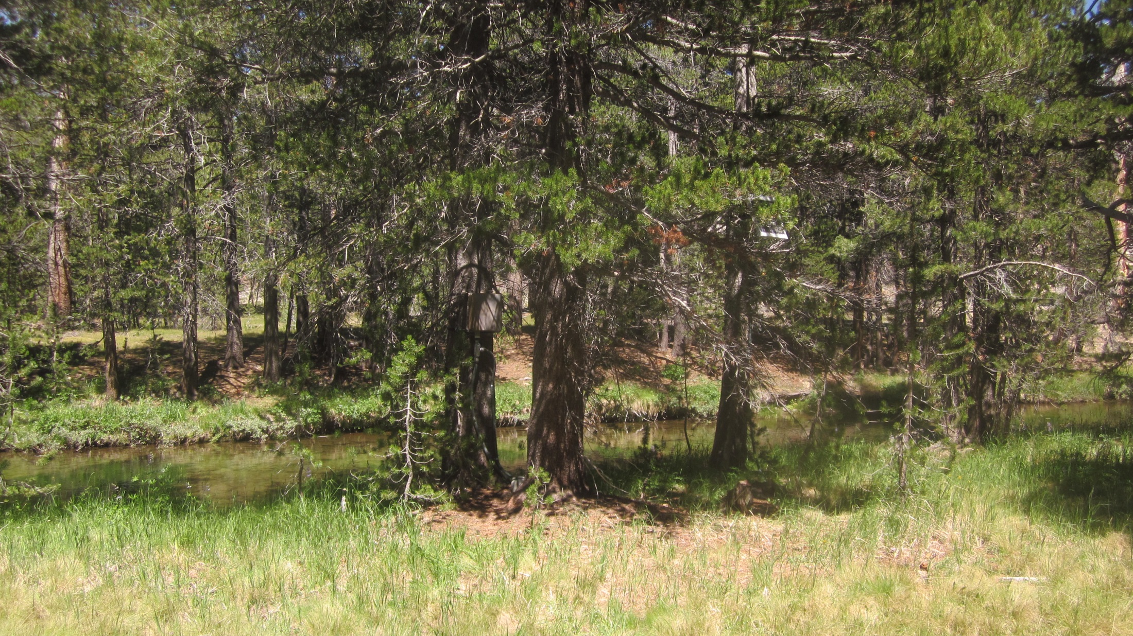
Datalogger enclosure
25 W Solar panel
Photo: 7/17/2015

